Slide 1

NETFLIX MOVIES AND TV SHOWS
GROUP 3 - VANESSA MUNOZ, DAVID MONTES, SHAWN TRAN, HANNAH HAE-IN KIM
Notes:
https://blog.usejournal.com/how-netflix-can-help-you-create-better-powerpoint-presentations-783d77c3e122

Slide 2
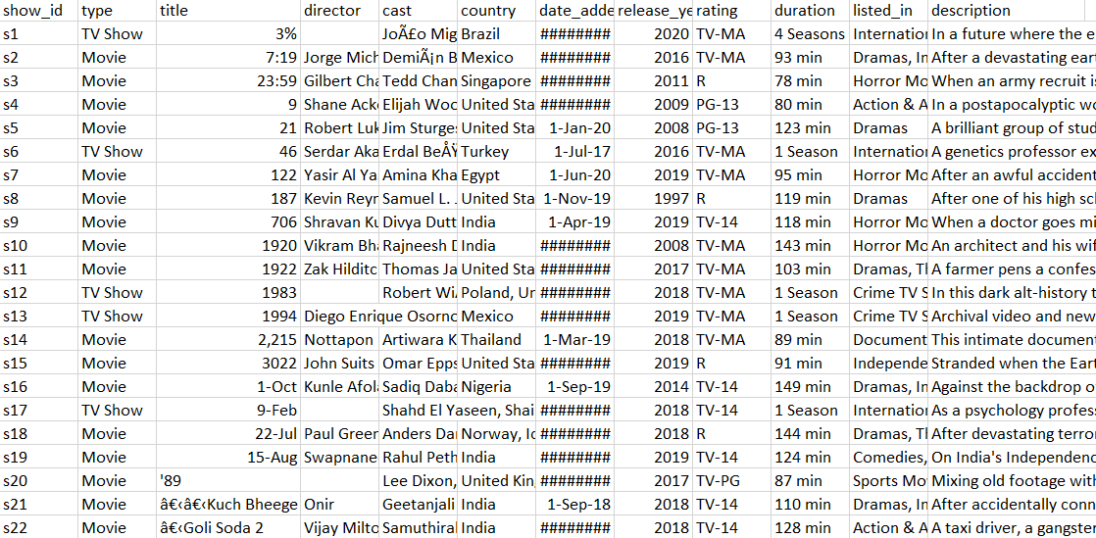
Brief Summary of Our Dataset:
7787 unique values
12 columns
3 MB
Name of file: netflix_titles.cvs
https://github.com/stran13/CIS3200Netflix
Kaggle source: https://www.kaggle.com/shivamb/netflix-shows
Screenshot of dataset in excel

Slide 3
Netflix Movies and TV Shows
Significance
With the data collected from the website Kaggle, Netflix can improve their streaming service.
We would ultimately like the Netflix subscribers growth to increase.
Overall, we would like all new Netflix subscribers to be content with using Netflix streaming service.

Slide 4
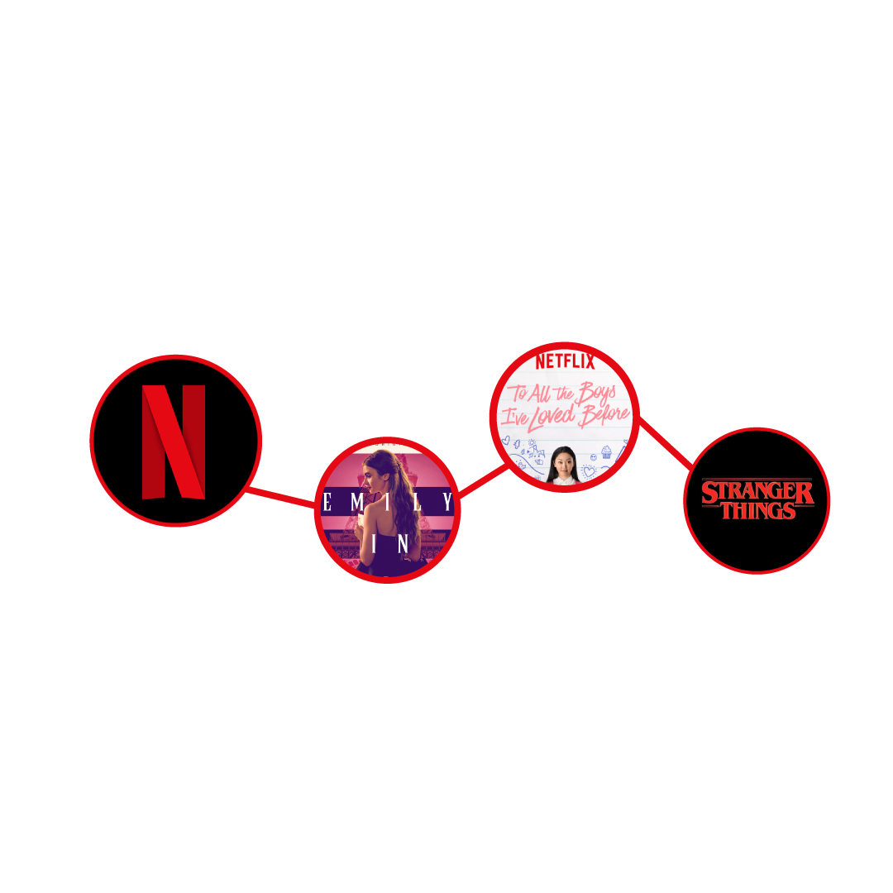
Netflix Background and History
Founders of Netflix: Marc Randolph and Reed Hastings
Netflix in the early 90’s
Today, Netflix streams movies and tv shows to users across the world.

Slide 5
Netflix Movies and TV Shows
Objective
Our group must produce an analytical dashboard with the data collected from the website Kaggle.
The overall objective focuses on developing and producing a movie and tv show dataset process for Netflix to maintain a future with analytics.

Slide 6
Netflix Movies and TV Shows
Netflix as a service and its own production company
Outsourced and in-house TV shows and Movies
Understanding the amount of content (shows and movies) that Netflix came out with during a specific time frame.
Release pattern.
Classification, organization, and visualization of data
Bar chart, Pie chart, Kibana
Understanding Netflix’s Database

Slide 7
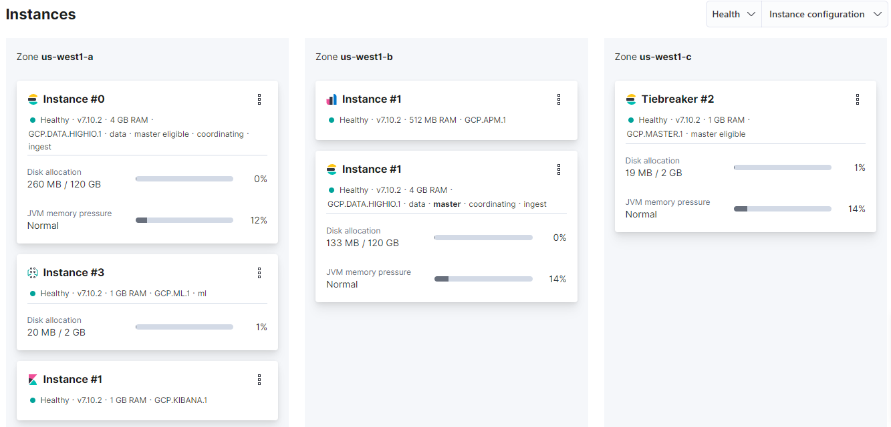
Hardware Specifications

Slide 8
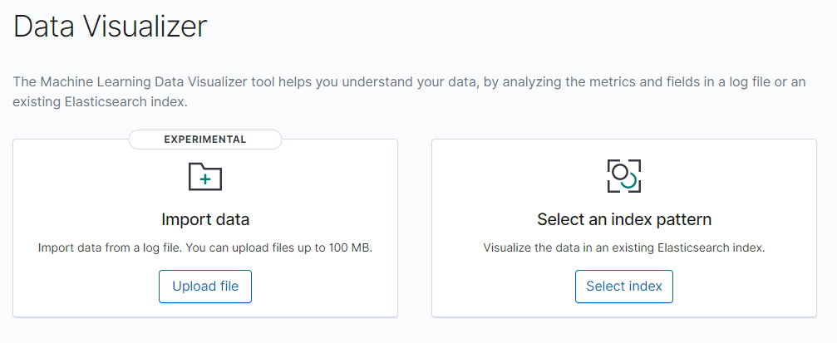
Uploading data to ES and Kibana
Utilized Data Visualizer tab under machine learning to upload data to Kibana.
From here we used the uploaded data to create an index pattern to visualize our data.

Slide 9
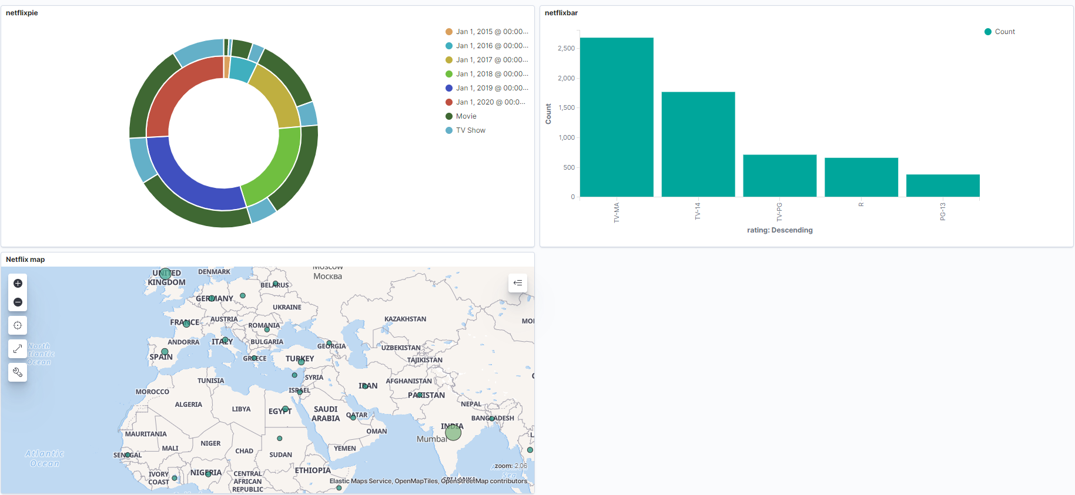
Dashboard

Slide 10
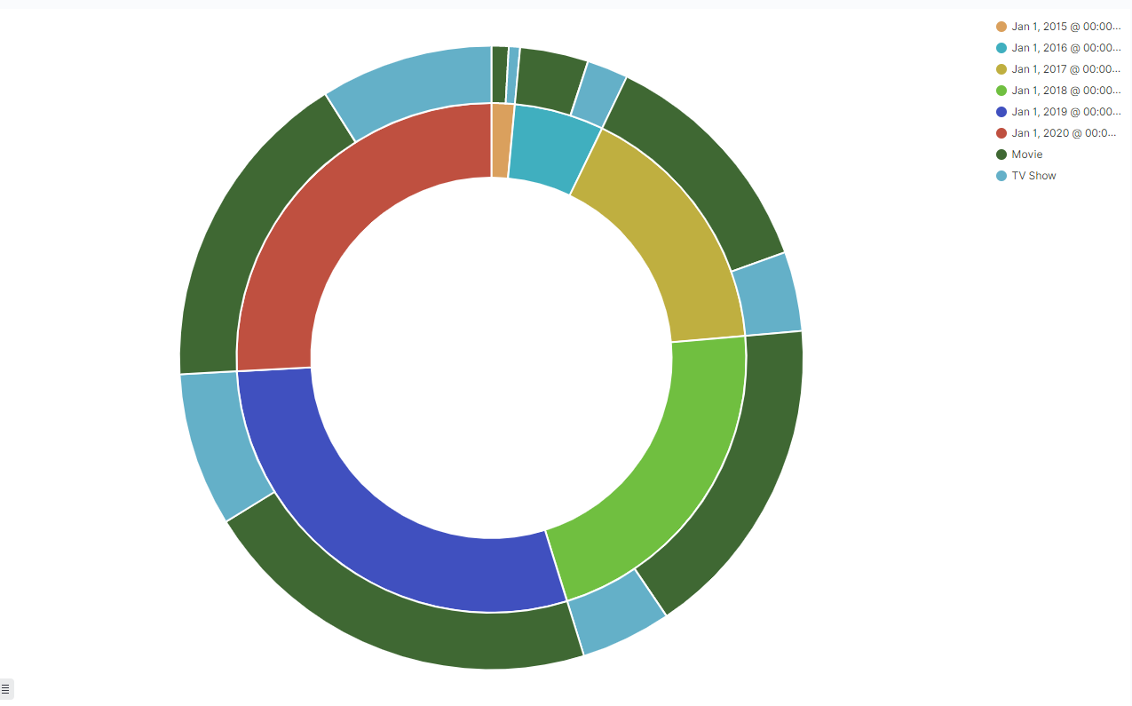
Pie chart: year added & type of film
Here we created a pie chart with the inner being years from 2015 to 2021.
The outer pie chart signifies how many releases were tv shows and how many were movies.

Slide 11
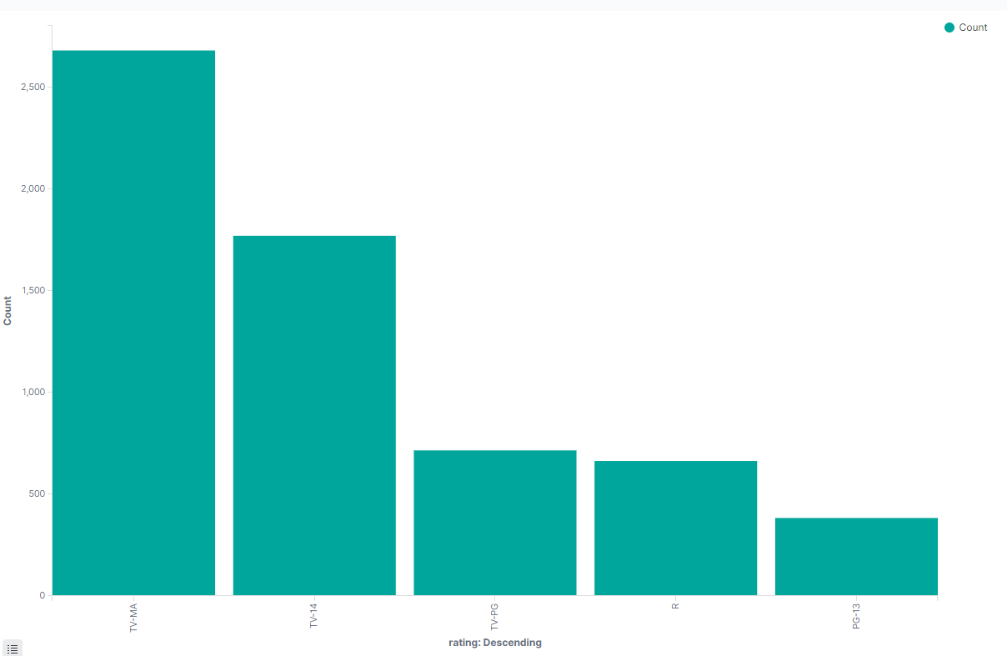
Bar Chart: number of specifically rated films
Here we utilized a vertical bar chart to display the counts of each rating of film.
Counts from highest to lowest
TV-MA : 2,680
TV-14 : 1,769
TV-PG : 715
R : 663
PG-13 : 383
Here we see that there’s a large amount of mature content on Netflix

Slide 12
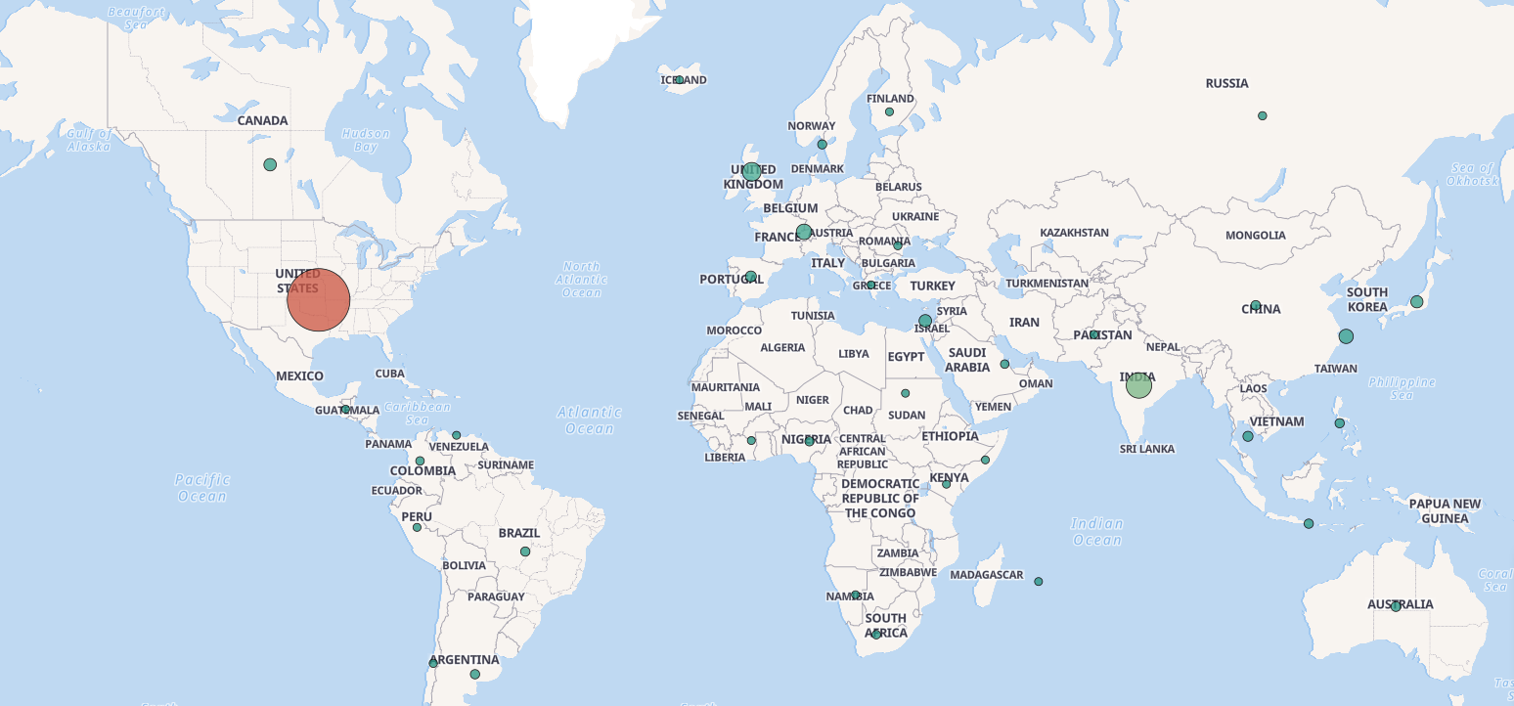
Geo Map

Slide 13
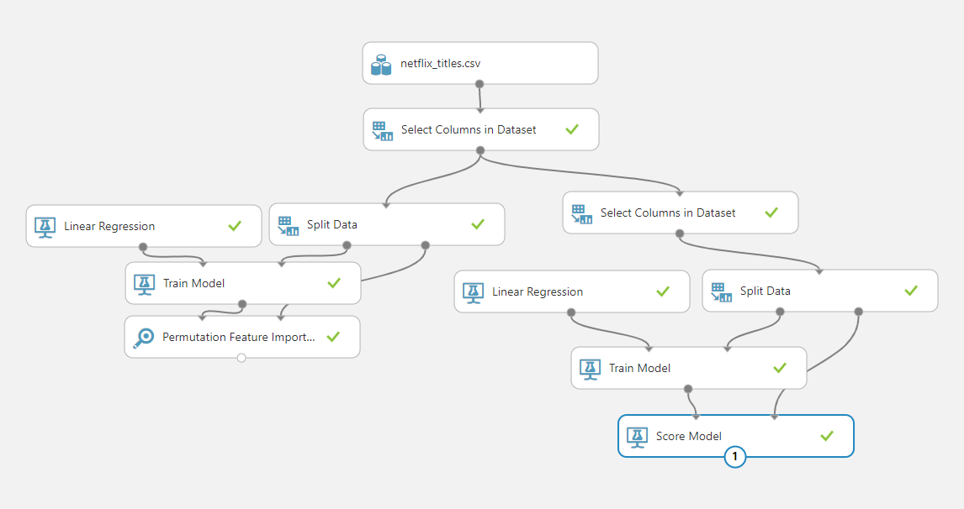
AzureML Modeling with Permutation Feature Importance
Created an experiment to predict duration of films based on other columns.
Permutation Feature Importance used to determine significance of certain columns on predicting duration.
Link: https://gallery.cortanaintelligence.com/Experiment/Netflix-titles-2

Slide 14
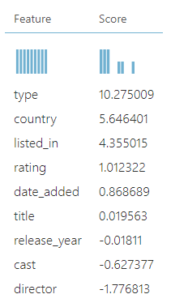
AzureML cont.
Visualization of Feature Importance.
Higher the score the more significant the feature is in predicting a column.
In this case duration.

Slide 15
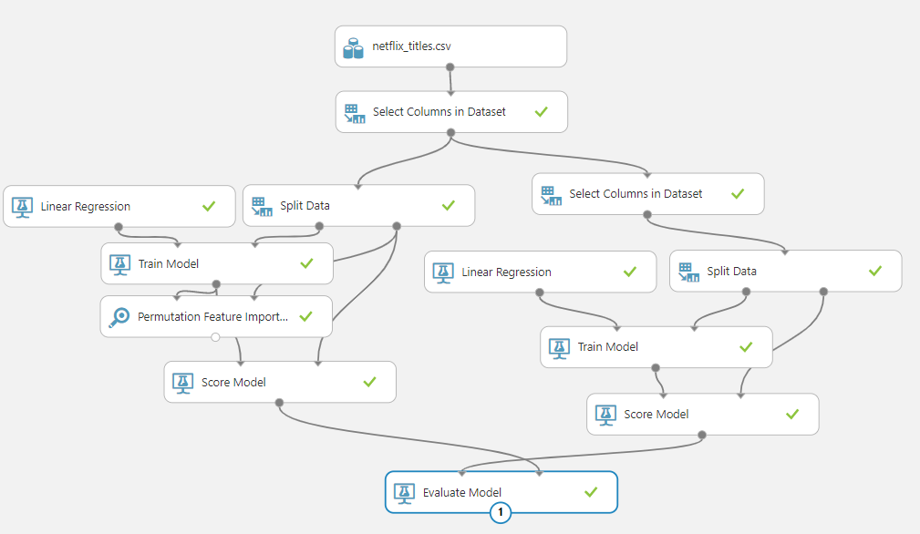
Evaluating Models
Here we added score model modules and an evaluate model module to determine the Coefficient of Determination and Root mean squared error of both models.

Slide 16
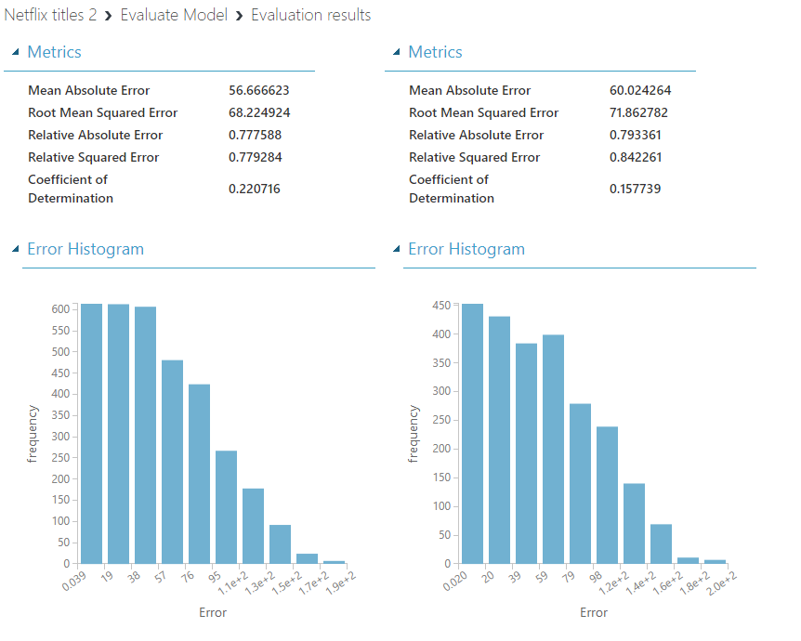
Evaluating Models cont.
Here we see the evaluation results for the two models we used.
We see the model on the left is better as it has a lower RMSE and a higher CoD.
Both models however are still not ideal as they both have low CoD and high RMSE.

Slide 17

Conclusion
We utilized data visualization tools to find hidden information and trends within the data.
Netflix can use these tools to find trends in shows that will become popular in the future.

Slide 18

Group 3
Thank you
Any Questions?

